Slide 1
Dewar Communication Cable Part 2

Slide 2
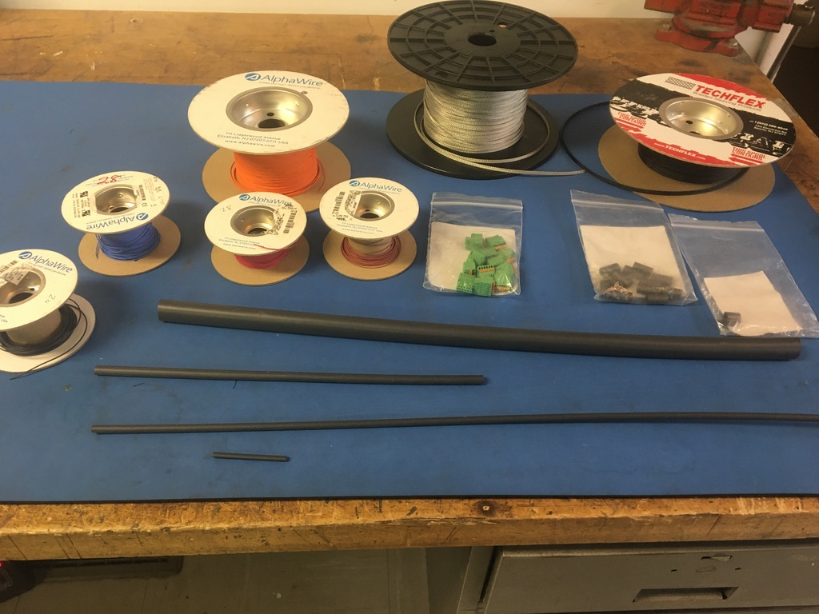
Materials

Slide 3
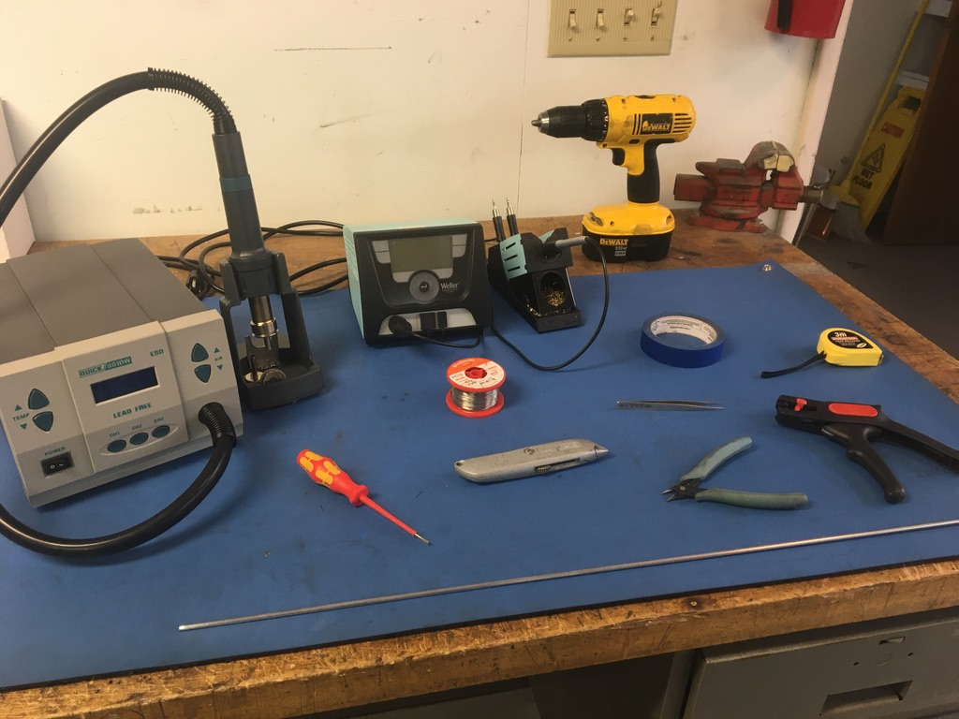
Tools

Slide 4
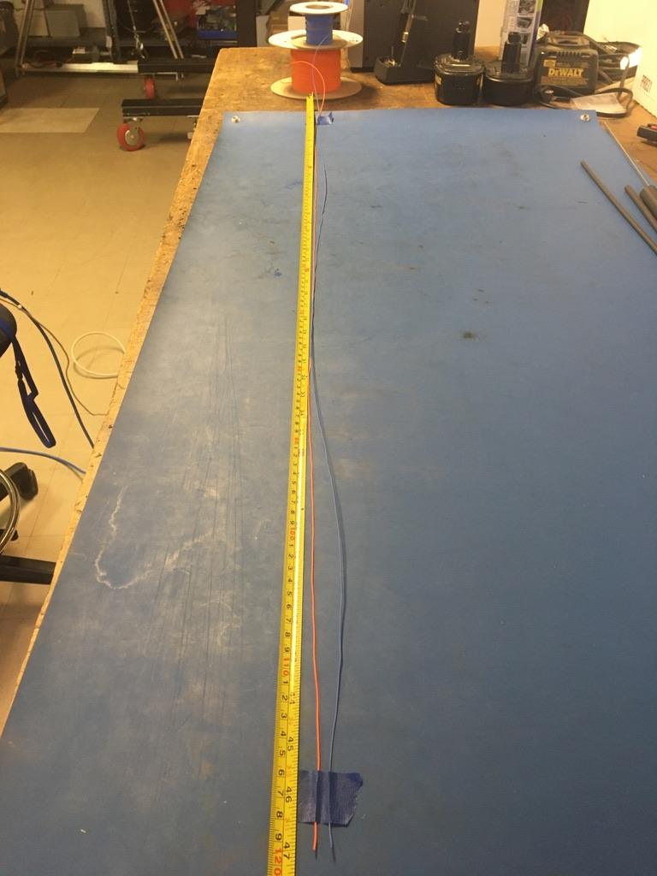
Measure out and cut 47 inches of orange, blue, brown and red 28 awg wire.

Slide 5
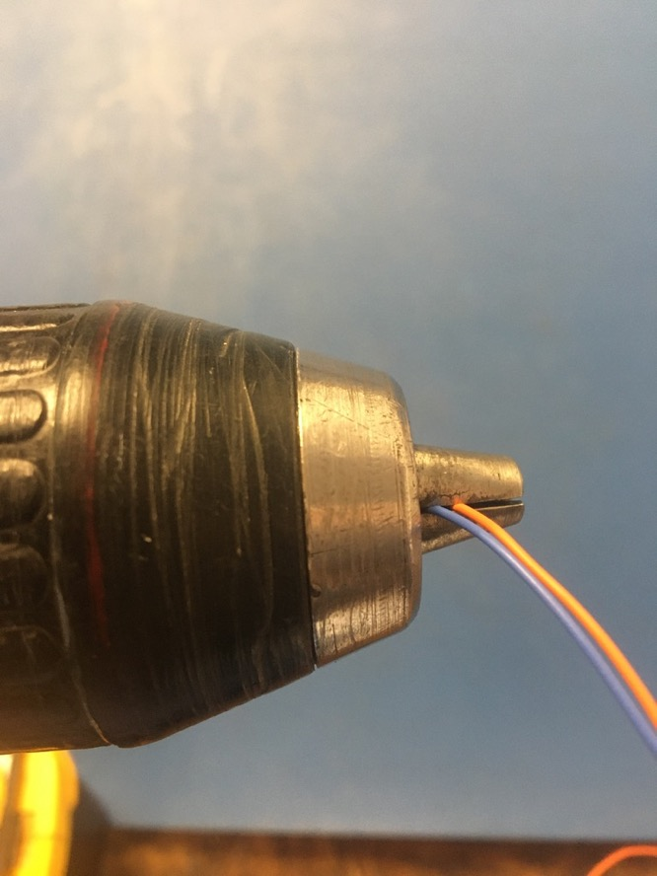
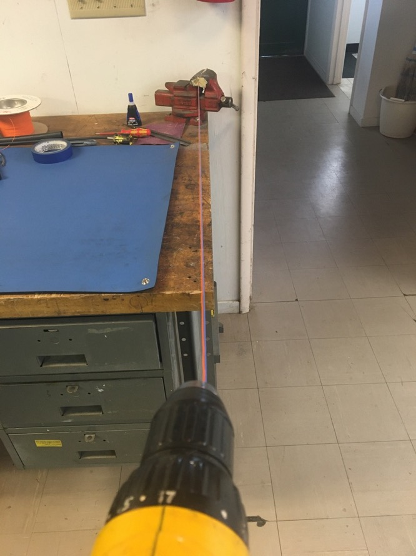
To make the twisted pairs, line the vise with masking tape. Put one end of the orange and blue wires into the vise and the other into the drill. Run the drill till the wires are sufficiently twisted (for reference see the next slide). Repeat with the brown and red wires.

Slide 6
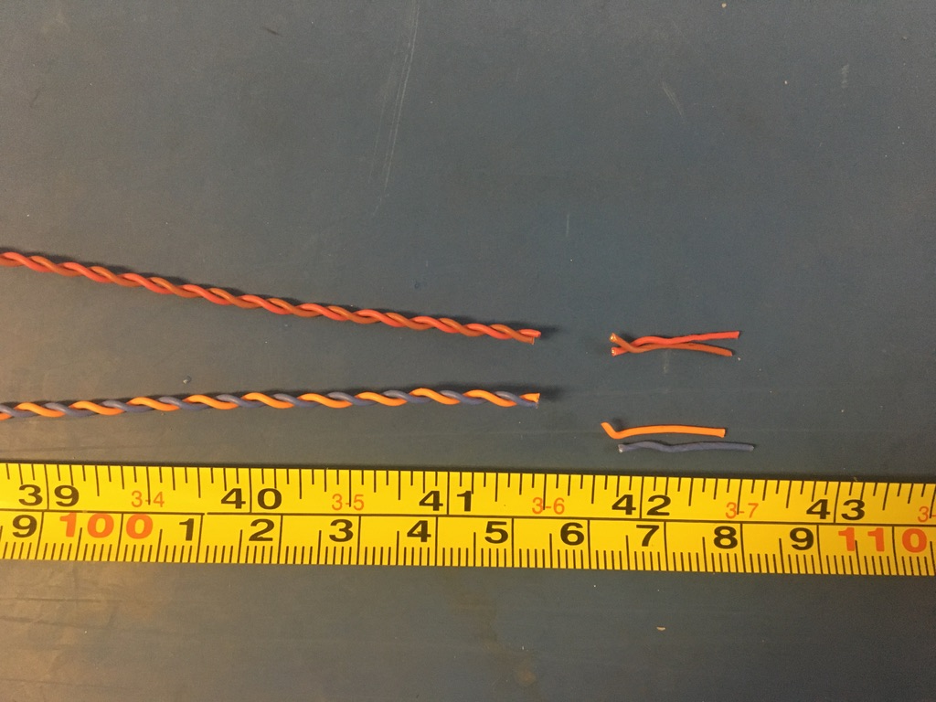
Trim the ends of the twist pairs where they were in the vise and drill. Once trimmed, they should measure about 41.5 inches.

Slide 7
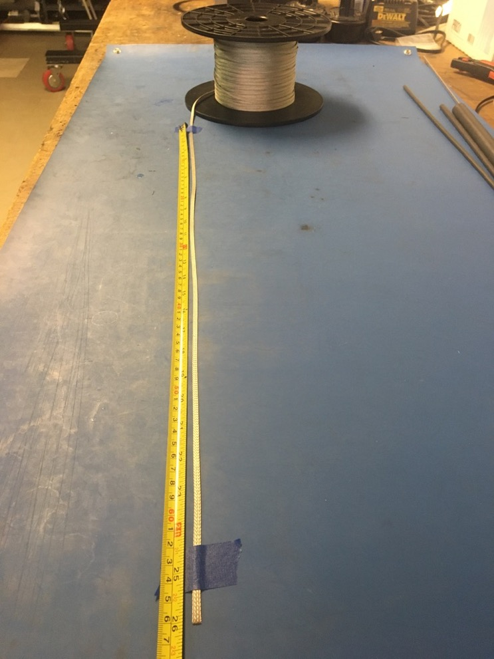
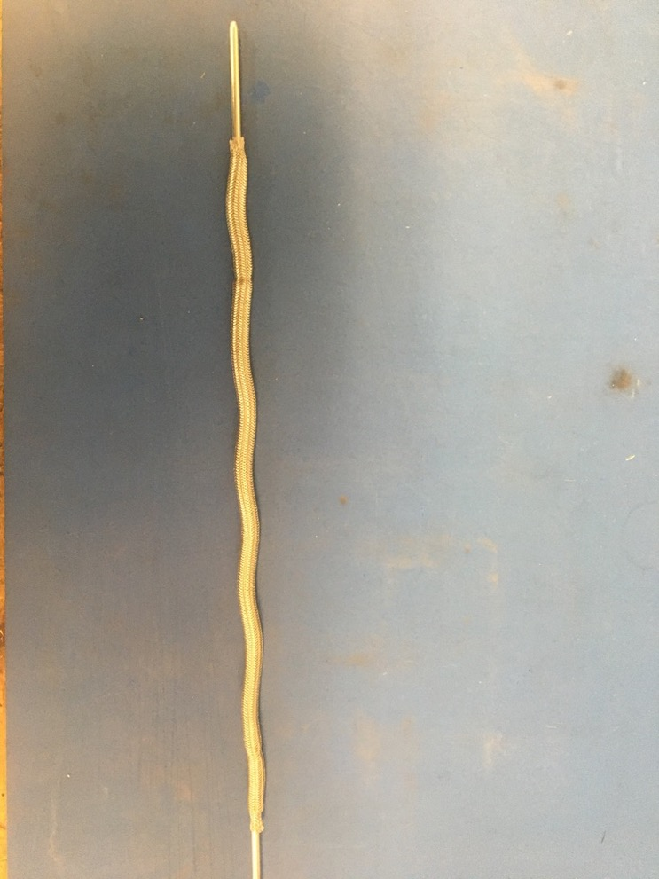
Measure out 26 inches of the 1/8th metal braid. Expand it using the metal rod.
measure

Slide 8
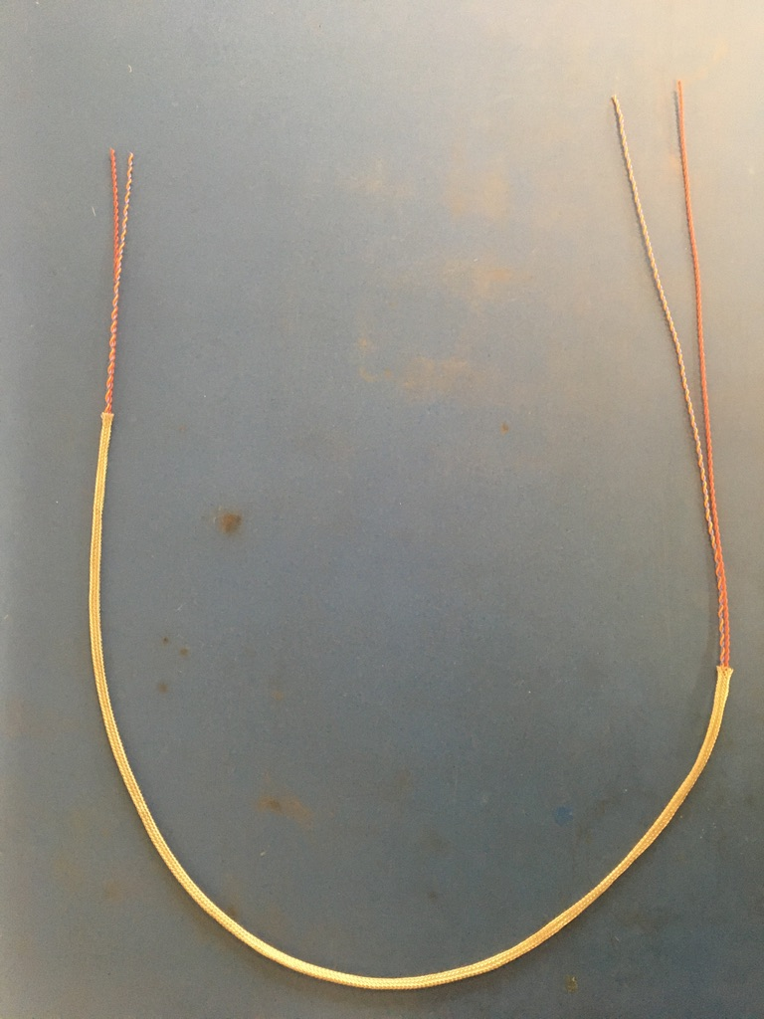
Put the twisted pair into the expanded metal braid as shown.

Slide 9
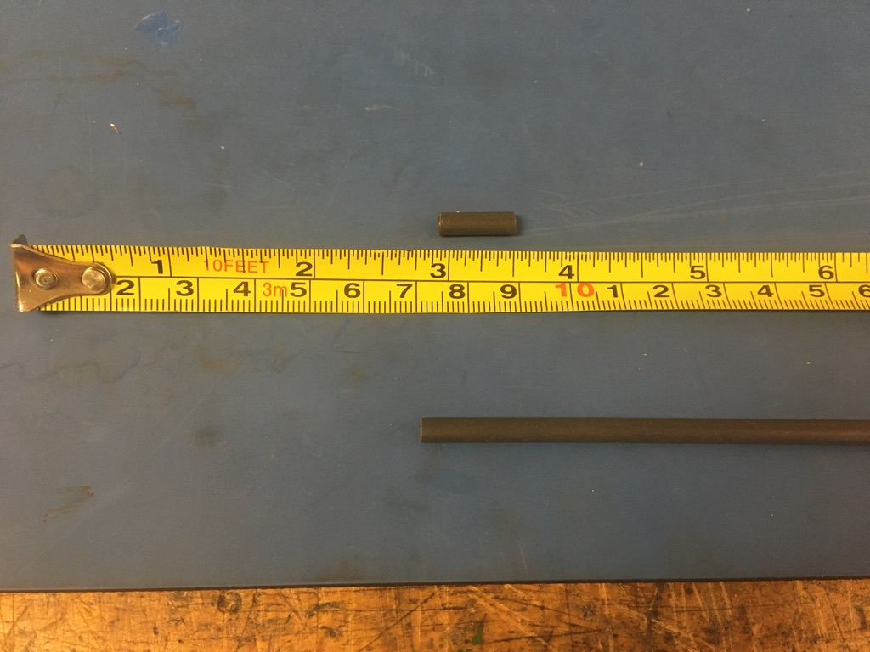
Measure out and cut two lengths of 4.8mm adhesive shrink tube each .5in long.

Slide 10
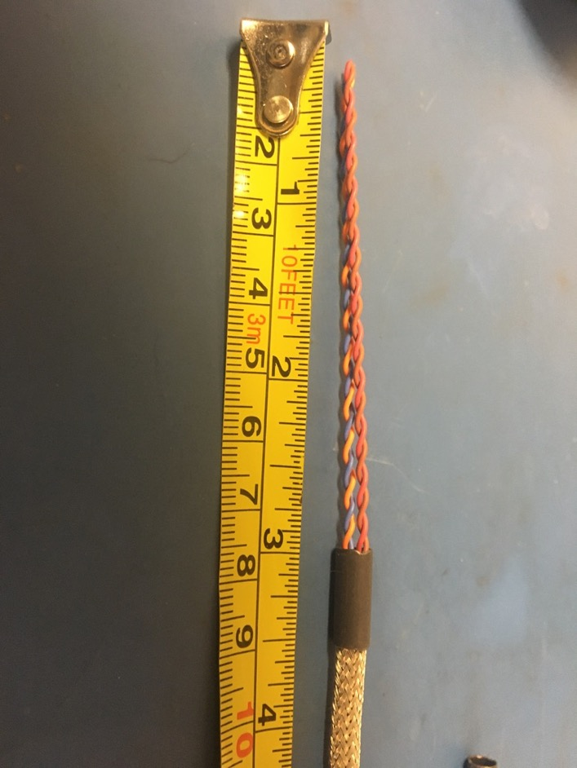
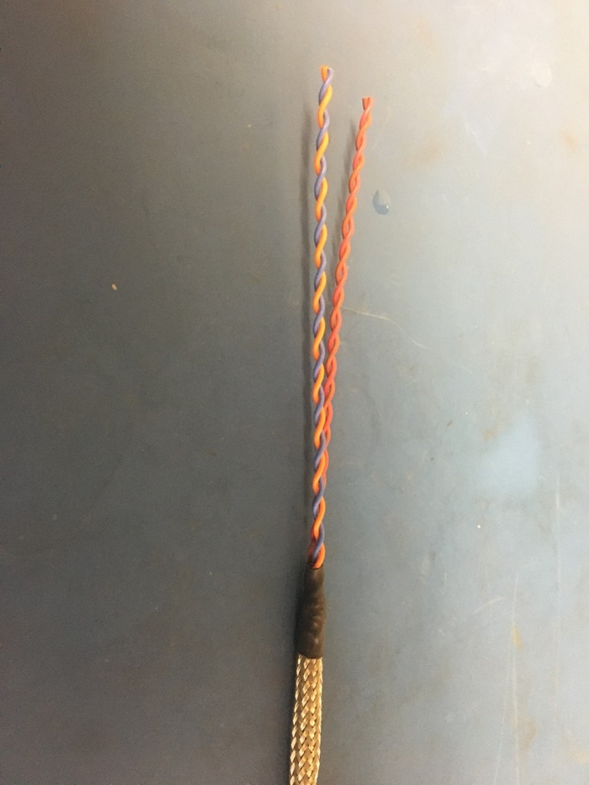
Put one piece of the shrink tube onto the end of the metal braid where the wires sticking out are shorter. Place the shrink tube such that the metal braid ends midway through it. The wires should measure 3 inches long. Apply the heat gun to the shrink tube.

Slide 11
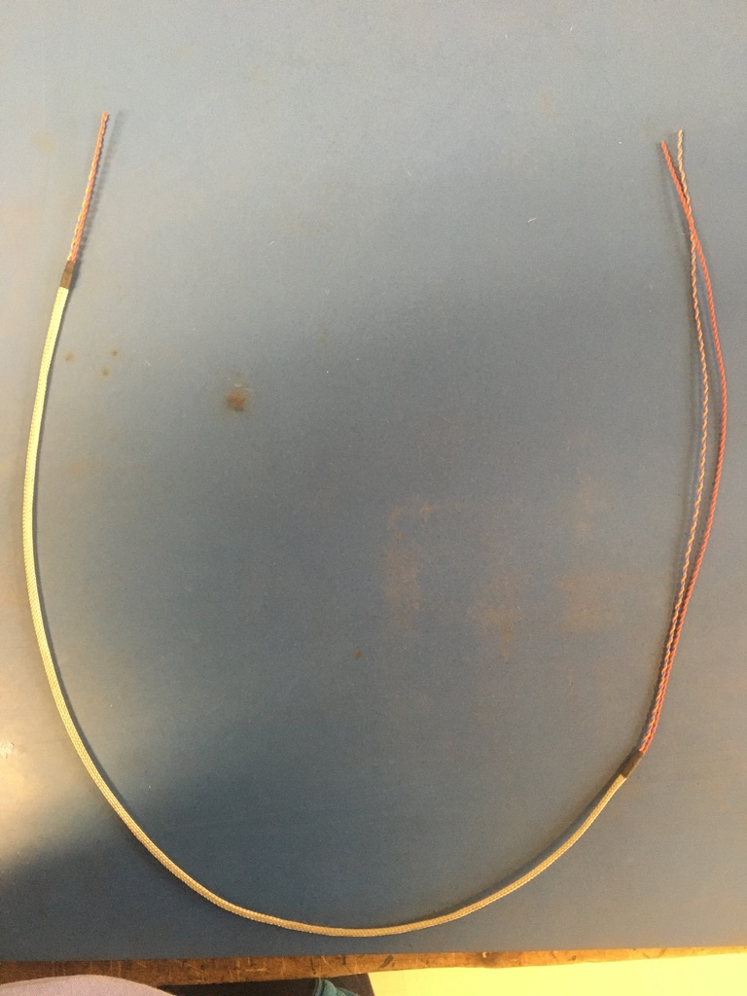
Repeat the process on the previous slide on the other end of the metal braid (though the wire does not need to be measured on this end). Thus far, the wire harness should appear as shown.

Slide 12
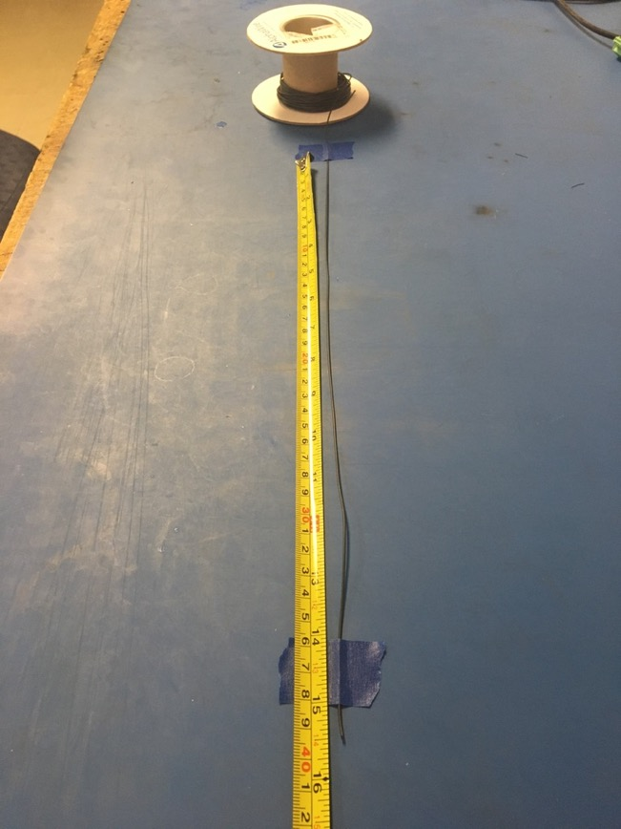
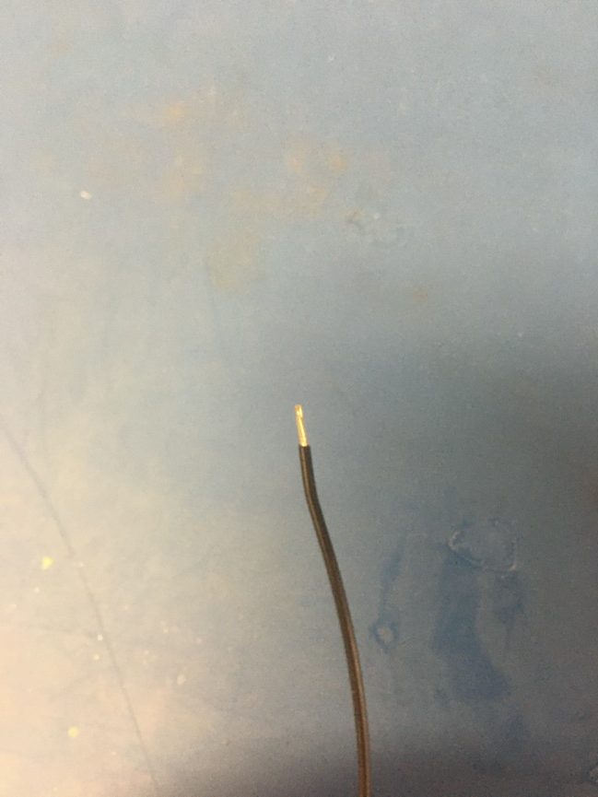
Measure out and cut 15.5 inches of black 24 awg wire. Strip 3-4mm off one end.

Slide 13
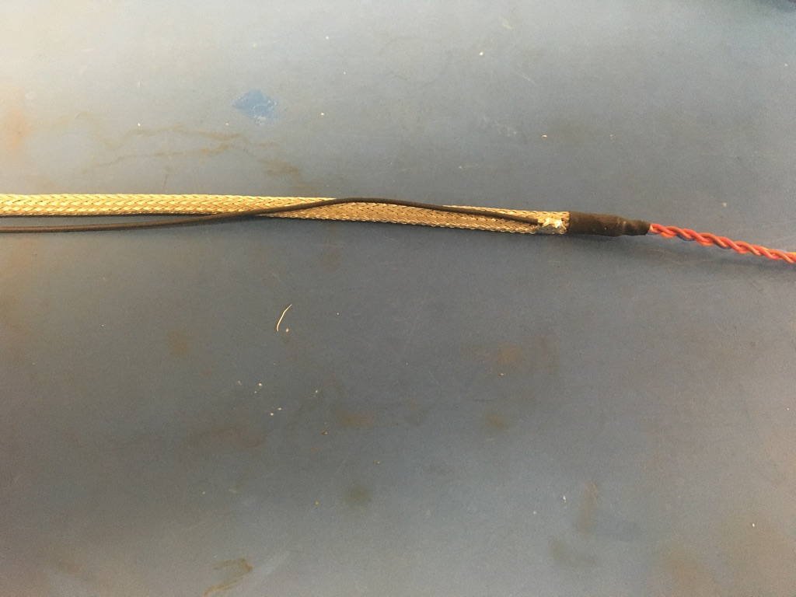
Solder the stripped end of the black wire onto the metal braid near the shrink tube joint with the longer length of wire (the end that was not measured). The black wire should be soldered so the that its length runs with that of the metal braid.

Slide 14
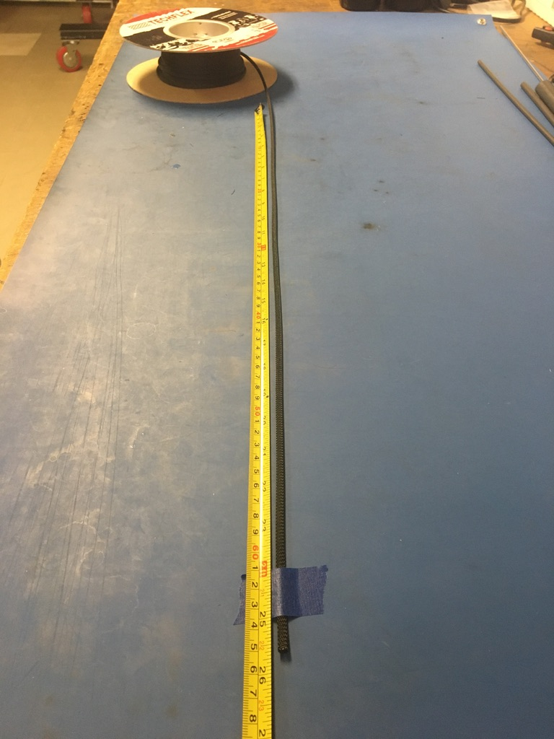
Measure out and cut 25.75 inches of 1/4th plastic braid.

Slide 15
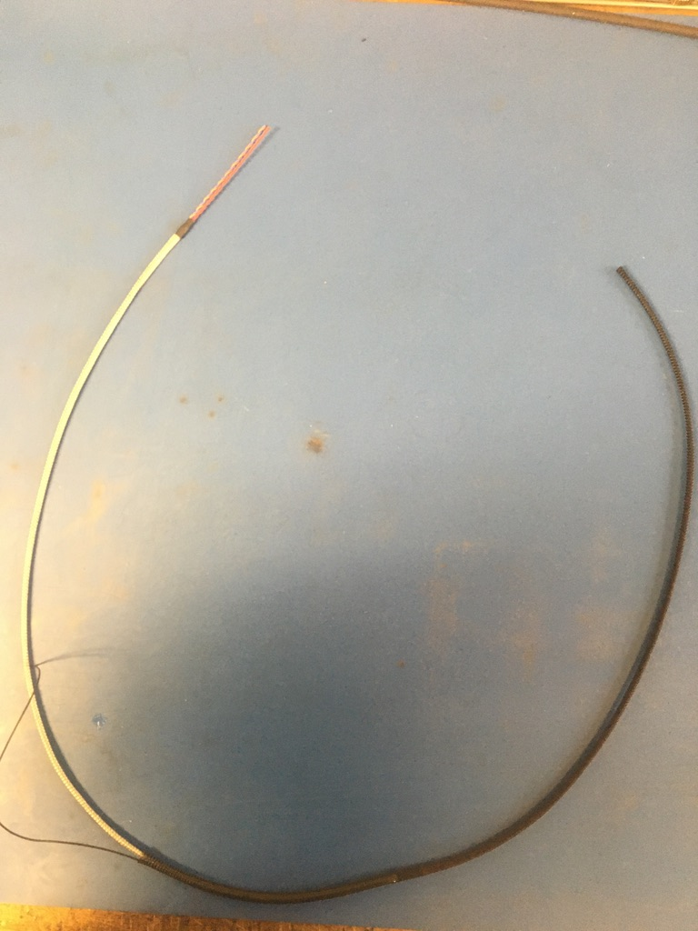
Put the plastic braid onto the wire harness. It does not matter from which end.

Slide 16
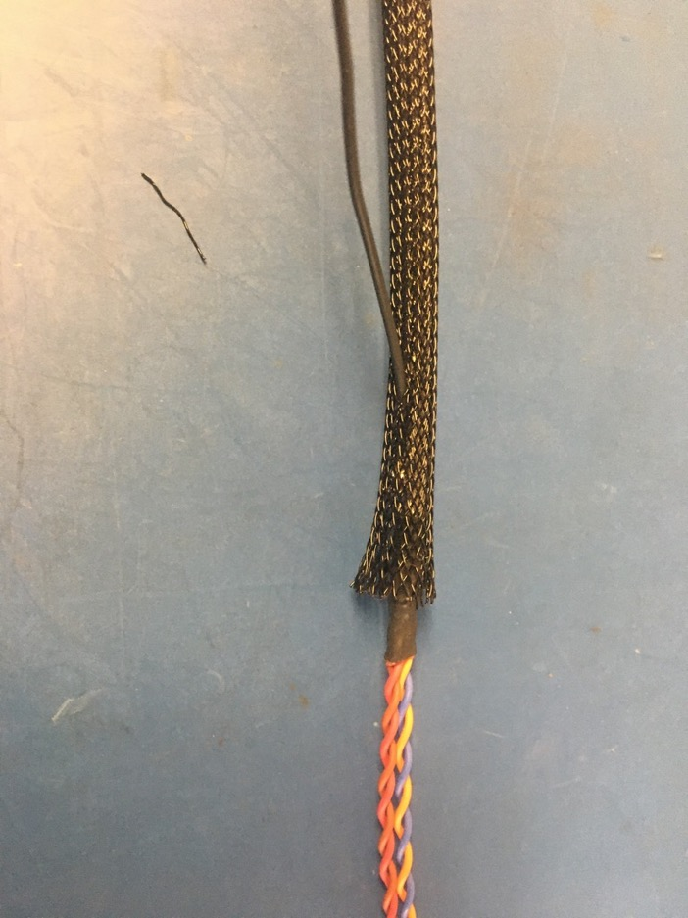
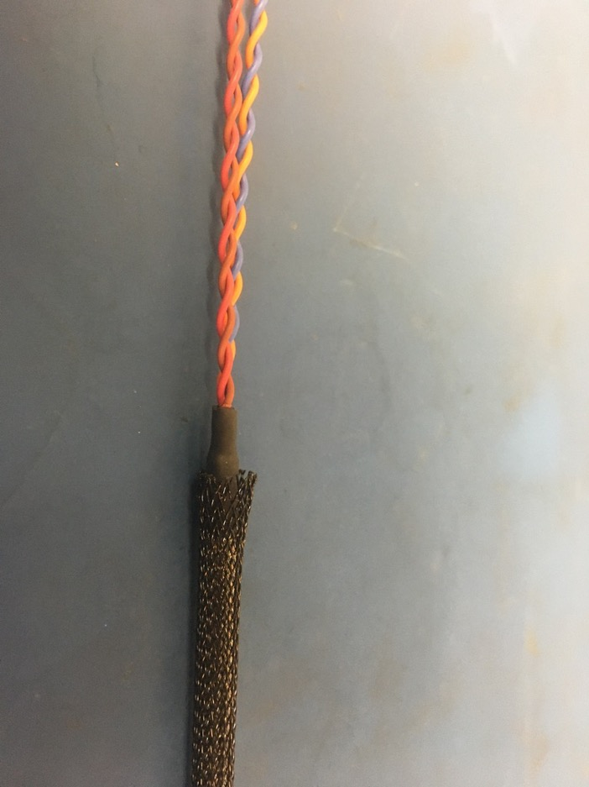
Thread the ground wire through one of the holes in the plastic braid so it appears as shown of the right. At each end of the harness, the plastic braid should end midway through the metal shrink tube joints.

Slide 17
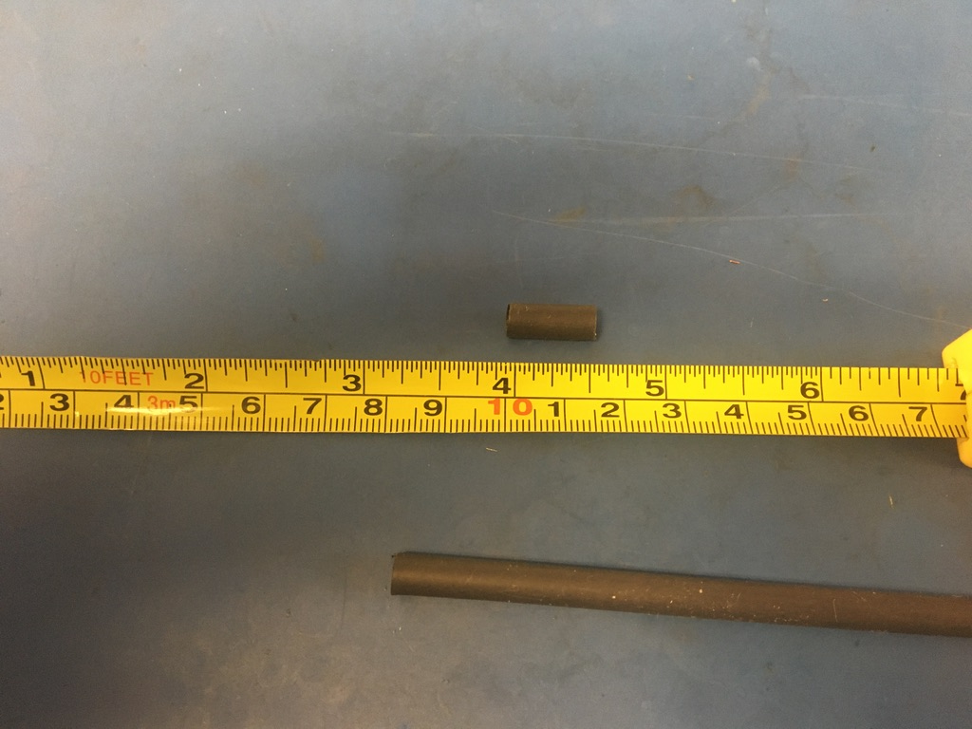
Measure out and cut one length of 6.4mm adhesive shrink tube that is .5in long.

Slide 18
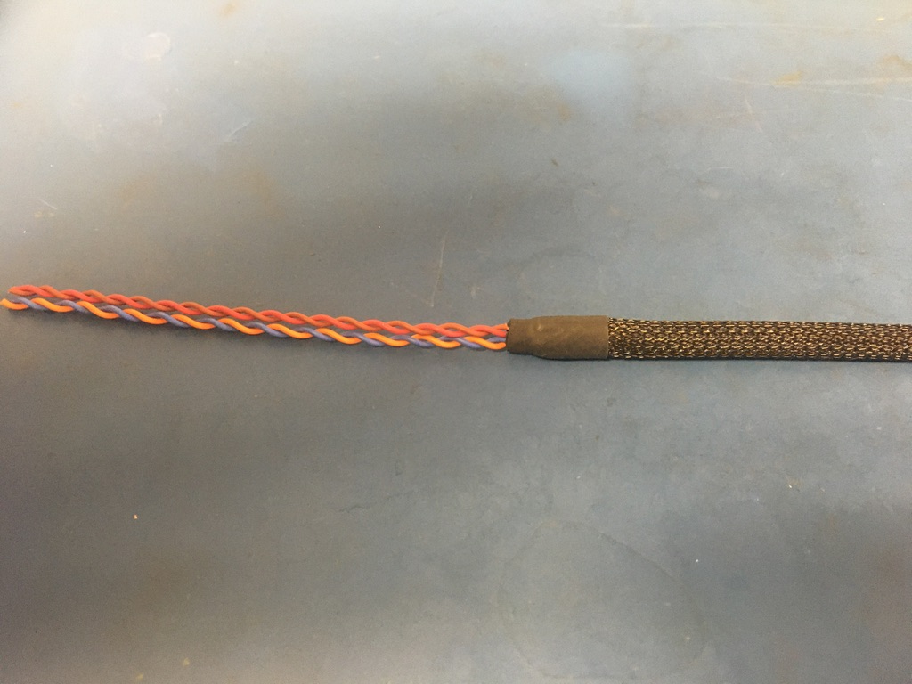
Place the piece of shrink tube onto the plastic braid end without the ground wire. The plastic braid should end midway through the piece of shrink tube. Apply the heat gun.

Slide 19
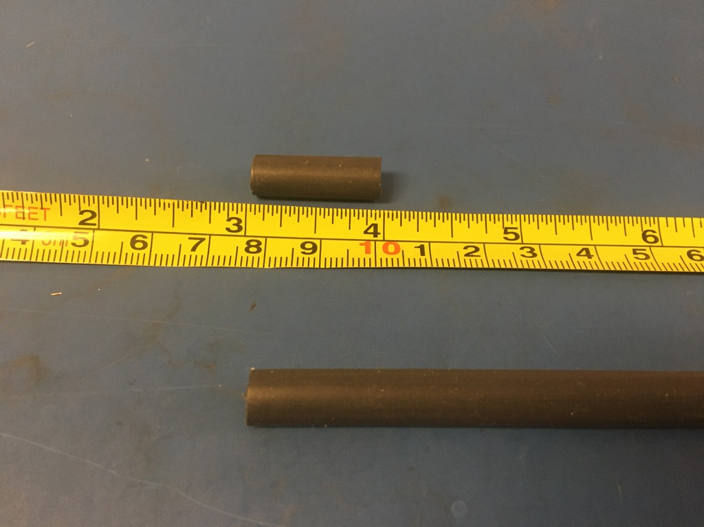
Measure out and cut one length of 6.4mm adhesive shrink tube that is 1in long.

Slide 20
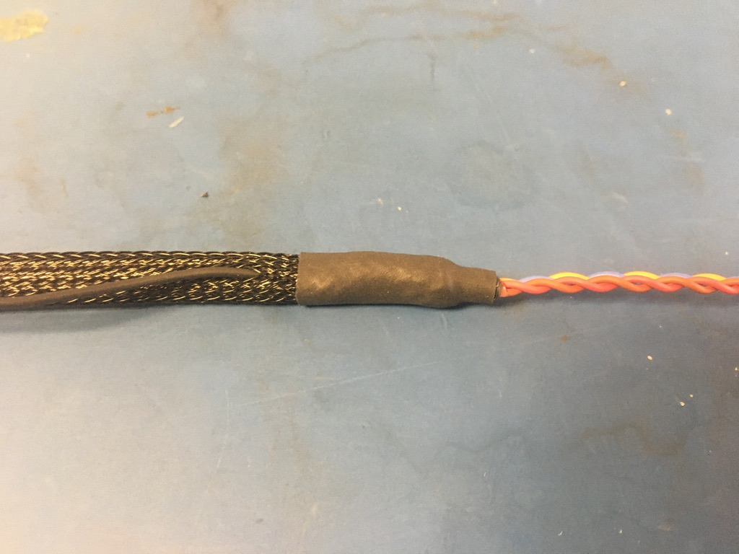
Place the piece of shrink tube onto the ground wire end of the harness. The shrink tube should be placed such that it covers the solder joint and the length of shrink tube beneath. Apply the heat gun.

Slide 21
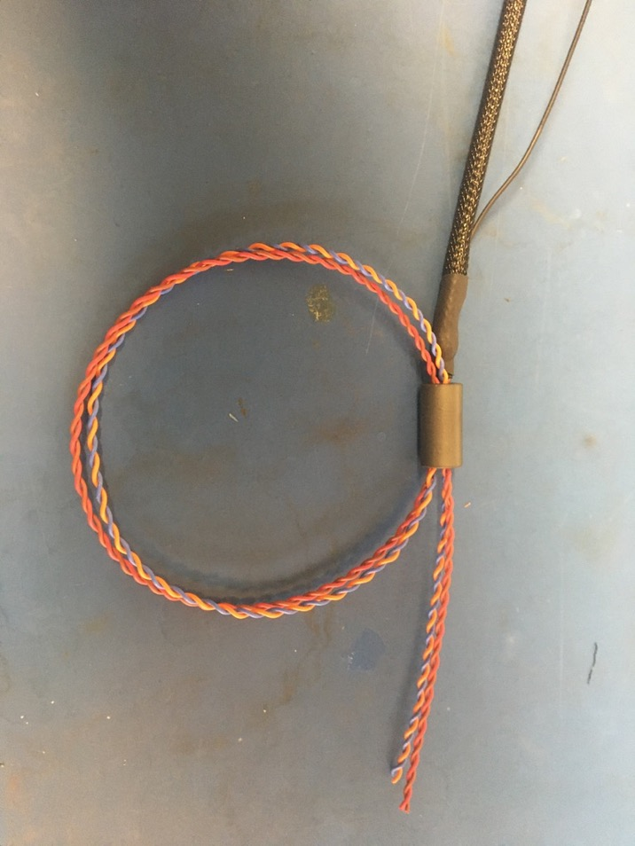
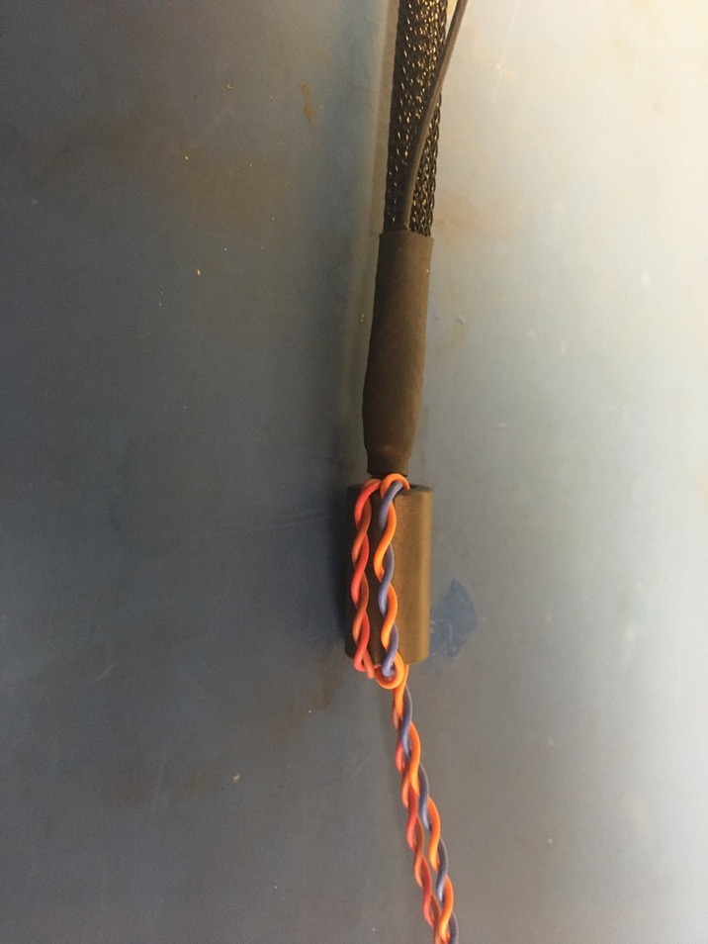
Thread the 75 magnet onto the end the wires on the end of the harness with the ground wire. Then thread the wires back through the bottom of the magnet as shown on the left. Pull the loop of wire taught so the magnet appears as shown on the right.

Slide 22
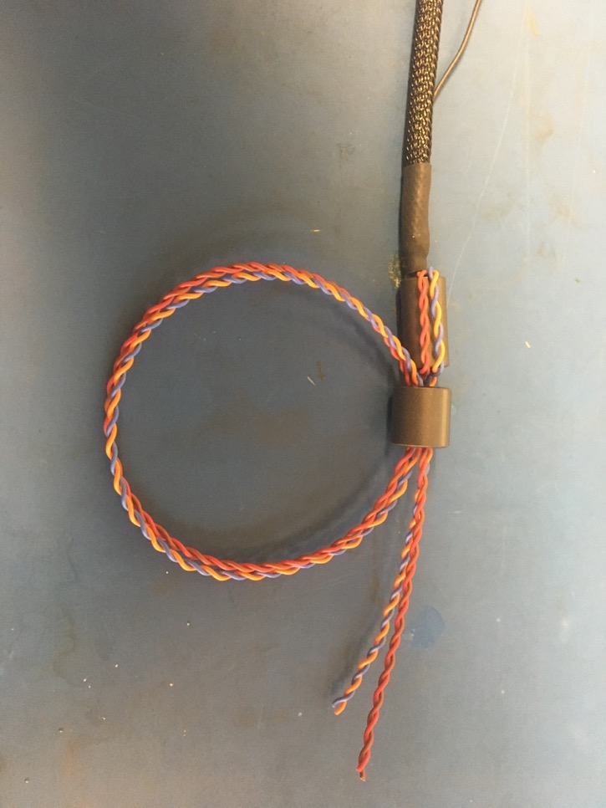
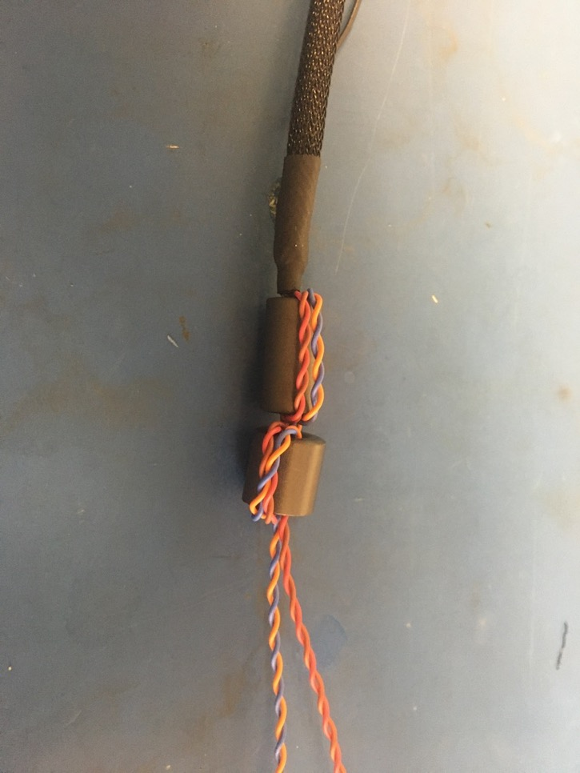
Thread the 43 magnet on just like the 75 magnet.

Slide 23
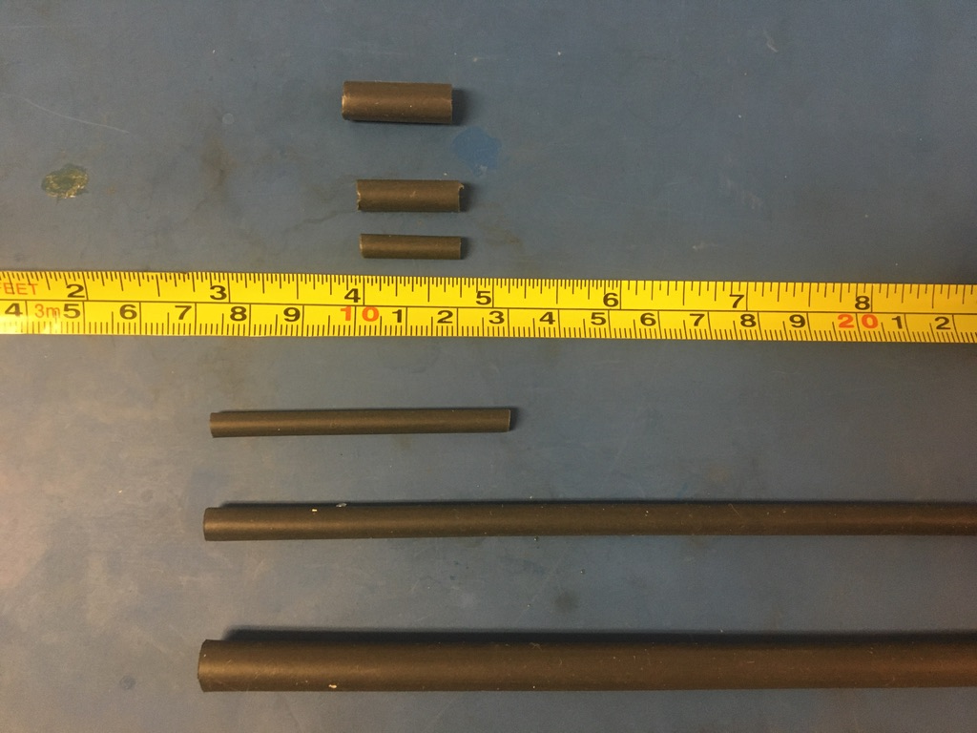
Measure out and cut 1in long lengths of 1/8th inch, 4.8mm, and 6.4mm adhesive shrink.

Slide 24
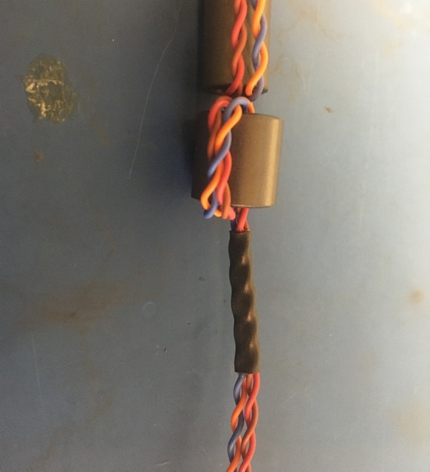
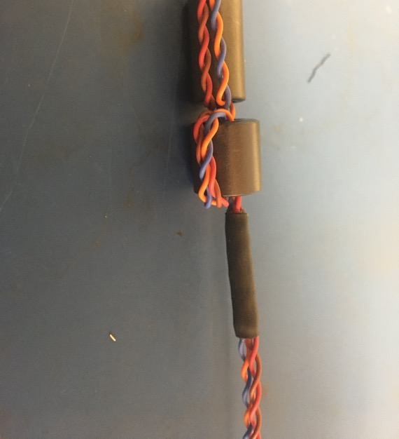
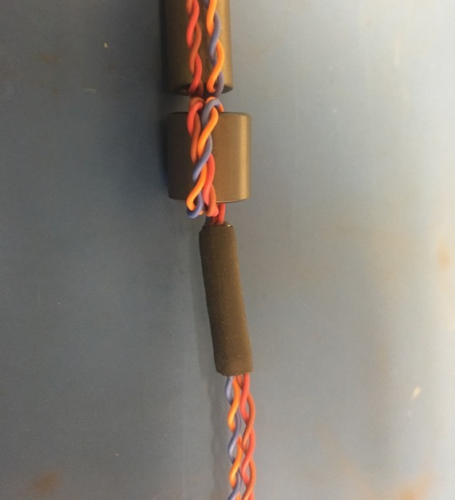
Place the 1/8th inch piece of shrink tube onto the wire harness such that it abuts the magnets. Apply the heat gun. Place the 4.8mm piece of shrink tube onto the wire harness such that it covers the 1/8th piece. Apply the heat gun. Repeat with the 6.4mm piece of shrink tube.

Slide 25
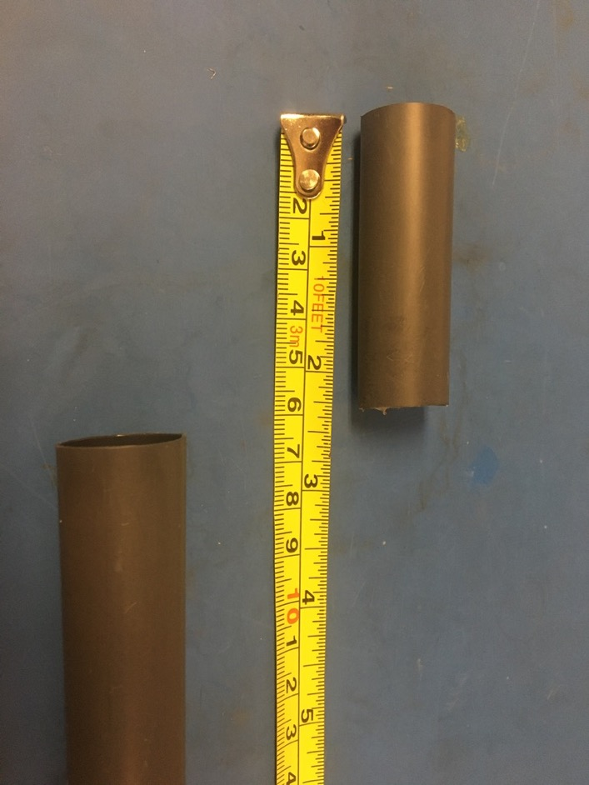
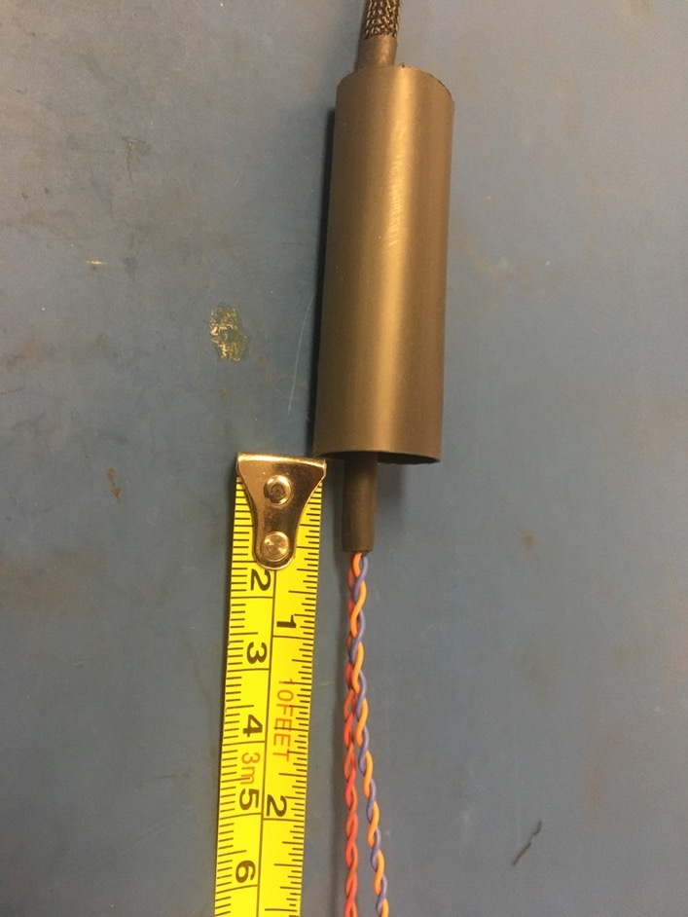
Measure out and cut one length of 16mm adhesive shrink tube that is 2.25in long. Place the piece of 16mm shrink tube over the magnets so that .5 inches of the shrink tube applied on the previous slide is visible as shown on the right.

Slide 26
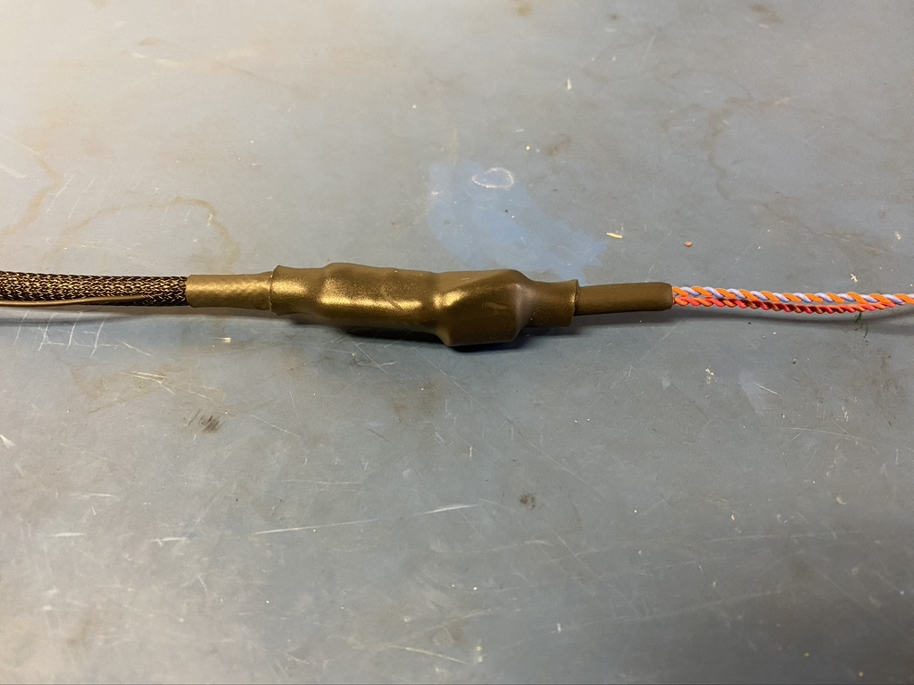
Apply the heat gun.

Slide 27
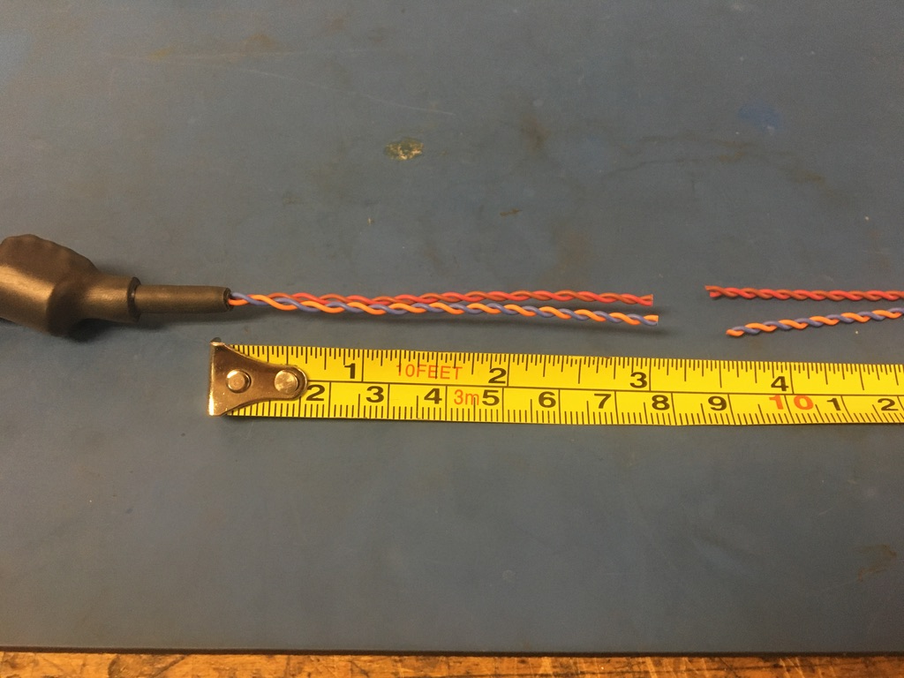
Measure and cut the twisted pairs on the magnet end of the harness so that they measure 3 inches.

Slide 28
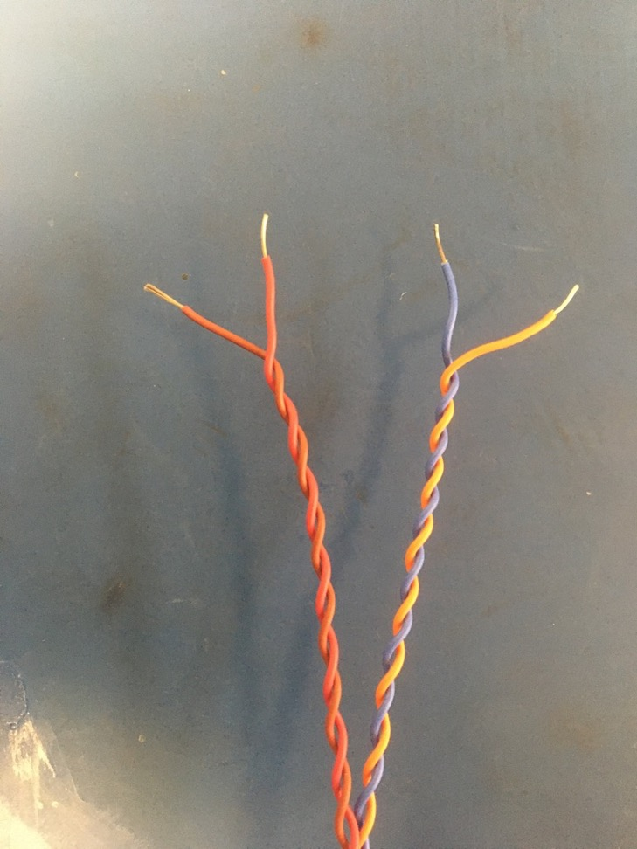
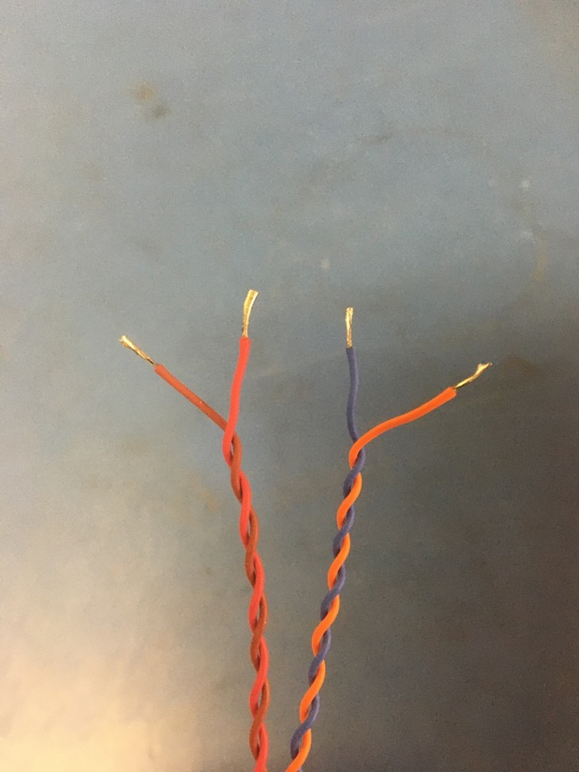
Strip all the wires (about 3-4mm) on the magnet end of the harness. Then solder the exposed wire.

Slide 29
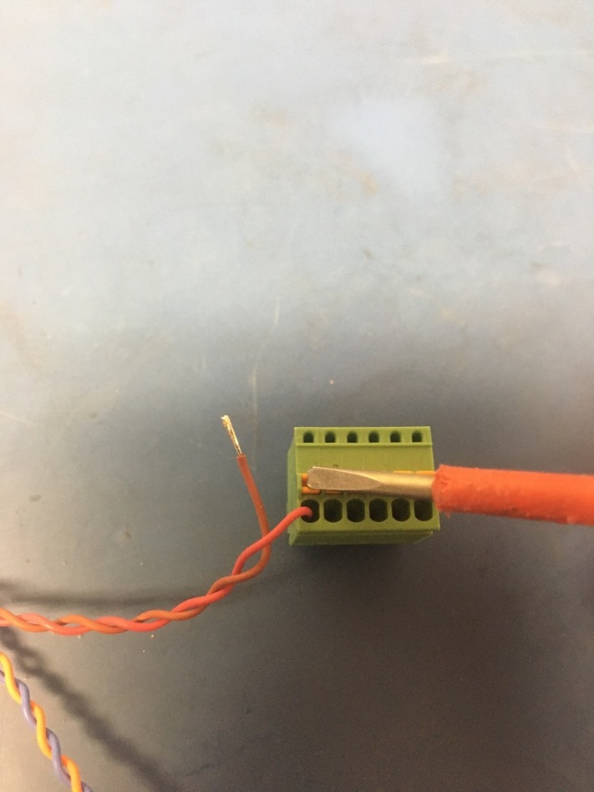
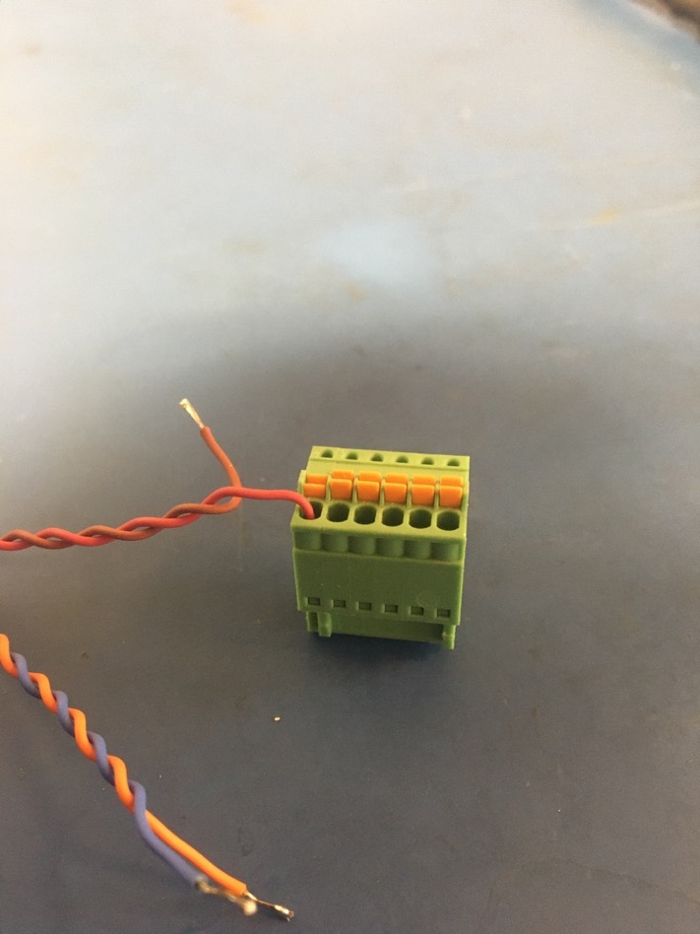
Insert the soldered wire ends into the green pluggable terminal block. To do so, press the orange button while inserting the wire. If done correctly, the orange button will appear depressed (as shown on the right) and the wire will not be easily pulled out of the terminal.

Slide 30
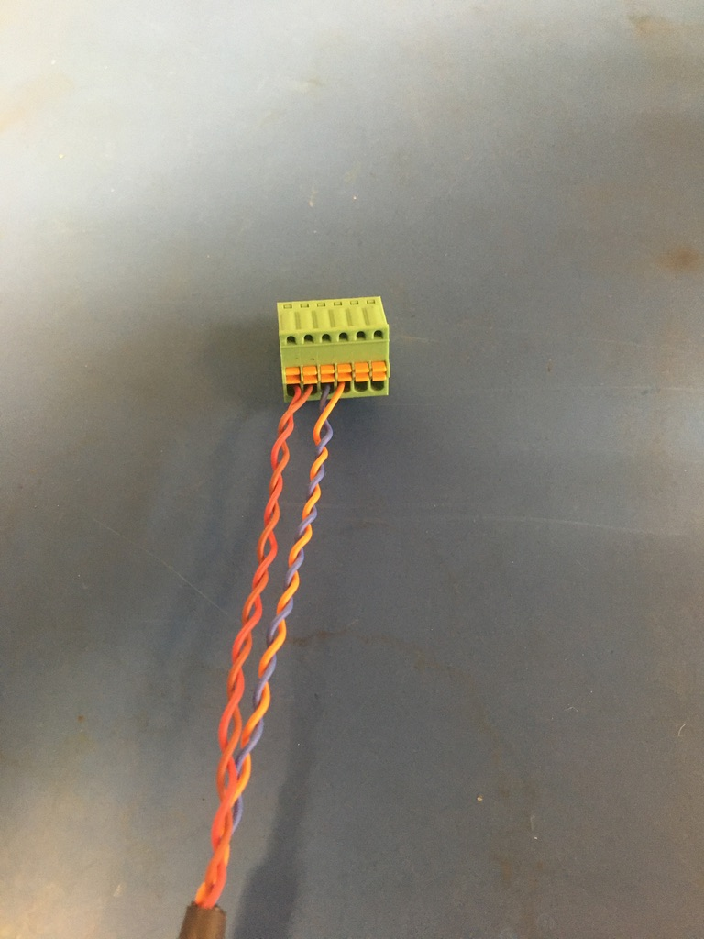
Repeat the process shown on the previous slide with all the wires. The position for each wire in the terminal is shown on the left and in the accompanying pin out document.

Slide 31
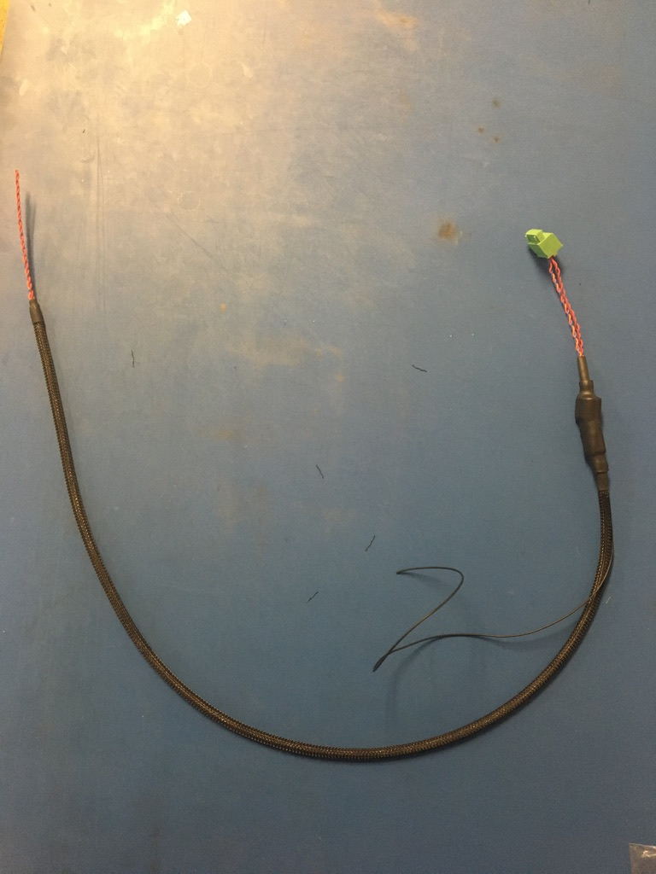
Part 2 of the wire harness complete! The ground wire will be given a tip later.

